Slide 1
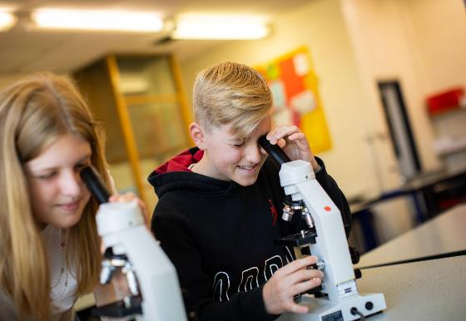
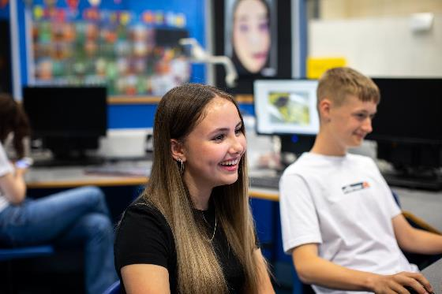
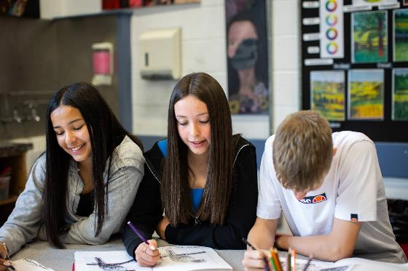
Year 6 Parents Information Evening
Monday 24th June 2024

Slide 2
Headteacher’s Welcome
Matilde Warden
Introducing the School

Slide 4
Inspire our students to have a boundless curiosity and a love of learning by providing, a broad choice of subjects, rich content and extra-curricular opportunities.
Instil a sense of belonging and community responsibility in a happy, safe and caring environment that celebrates diversity, underpinned by our ‘Respect for All, By All’ ethos.
Develop resilience, enabling students to overcome both academic and personal barriers.
Build independence and students’ belief in themselves, giving them the confidence to be who they are.
Ensure students have the opportunity to become ‘who they aspire to be’ and the best version of themselves by continually guiding them in how to improve towards their academic and personal goals and fulfil their potential
School Aims

Slide 5
Matilde Warden
Headteacher
Hannah Evans
Deputy Head
Robert Turner
Assistant Head
Ros Conroy
SENDCO
Gavin Brookes
Assistant Head
Mark Kaczmierczak
Assistant Head
Paul Brumby
Head of 6th Form
Stewart Summerell
Associate Assistant Head

Slide 6
Hello!
I have worked at Belper school for 29 years
I feel very fortunate to work in this school and be part of such a supportive community
I’m very excited for all of you to join us!
Head of Year 7
Rachel Warren
Notes:
I have not left Belper school for many reasons, mainly the students. The ethos of care and kindness is unique. I have the fortunate role of being able to nurture the personal growth of your children. Mention ARAS briefly. Typical things to expect as they settle.
6

Slide 7
Tutor Groups
Tutor groups are carefully constructed based on the following:
Information given by primary schools
SATS results
Primary Teacher assessments
Transition days observations
It’s very important to remember that tutor groups are mixed ability teaching groups as our priority is the students’ learning
Transition days 25th & 26th
Transition groups are not the same as tutor groups, we’re still waiting for SATs results and some information from primaries and so these groups are about having a positive transition experience
Notes:
In the past there has been some confusion over tutor groups so I wanted to explain the process to you.
Slide notes
Once Tutor groups have been formed, it is unlikely that they will change.
7

Slide 8
The Role of The Tutor
Establish daily contact with students at registration.
Provide encouragement and support
Monitor academic achievement
Communicate and link between student, staff and Head of Year
Teach PSHE during the morning form lessons
Notes:
Tutor centrality. The start to every day is often the most difficult part. Ensuring that students are set up for the day in the right way can make a difference to their self esteem and ability to meet the academic and social challenges of the day.

Slide 9
Quality of Education
We offer a broad range of learning experiences both inside and outside of the classroom
High quality teaching and learning with high expectations for all students
Wide variety of extra-curricular opportunities
Hannah Evans
Deputy Head
Notes:
9

Slide 10
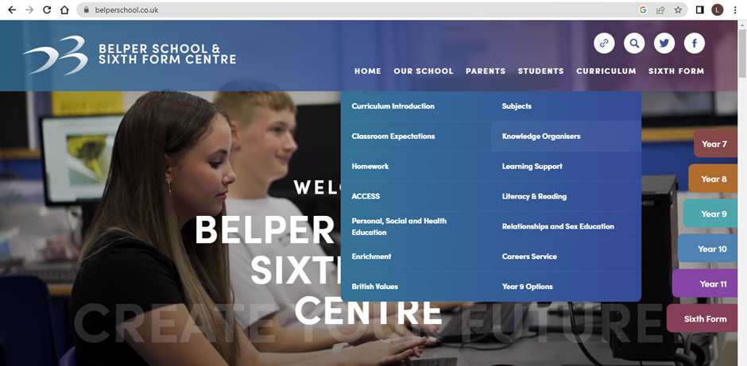
Knowledge Organisers

Slide 11
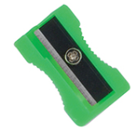
2 Black/Blue Pens and 1 Coloured Pen
2 Pencils
Scientific Calculator
Eraser
Pencil Sharpener
Ruler

Slide 12
Homework
All set on the app ‘Bromcom’
Examples of the type of homework students receive
complete exercises or questions set online
reading or research
revision and retrieval using the Knowledge Organisers
written tasks
Hannah Evans
Deputy Head
Notes:
12

Slide 13
Behaviour and Culture
Making sure students feel happy and safe in school
Setting behaviour expectations so that all students are able to learn
Helping students build the skills they will need to get through their school years but also through life!
Robert Turner
Assistant Head
Notes:
13

Slide 14
Good Behaviour Improves Everything
Academic outcomes
Wellbeing & Mental Health
Interpersonal & social skills
Kindness to others
Feeling safe enables everyone to reach their full potential
Robert Turner
Assistant Head
Notes:
14

Slide 15
Notes:
These are our Be Belper values that are embedded in our school community. Staff closely monitor positive behaviour and log when they see a student carrying out these behaviours on Bromcom

Slide 16
Rewarding hard work and effort
Half Termly Merit exchange shop
Ritz cinema trip
Celebration evening
Termly Head of Year celebration assembly
Golden ticket
Student of the fortnight
Robert Turner
Assistant Head
Notes:
Here are just a few examples of how we reward students behaviour in Belper. We have developed a range of ways to celebrate hard work and effort and students will strive to be the best version of themselves to achieve merits.
16

Slide 17
Your role as parents/carers
You’re the experts on your children!
Encourage your child to ‘Be Belper’!
Help us build your child’s resilience
Check Bromcom daily
Check the website regularly
Check that your child has their school bag and equipment needed each day
Contact the school office if there is a concern or query – not everything a child tells their parents is 100% accurate
Robert Turner
Assistant Head
Notes:
We need you to share what knowledge you have about your child
We need you to support your child and take an active interest in what your child is doing in school
Of course you will side with your child, what good parent wouldn’t, but if there is a problem remember that from your child perspective it is better to see the adults working together to resolve any issues
17

Slide 18
Common Parental Questions
Dress code
Toilets & filling water bottles
Mobile devices
Piercings
Detentions, staff are expected to follow the behaviour policy consistently
Robert Turner
Assistant Head
Notes:
Common questions asked by parents
Dress code is available on the website
Mobile can be used during social time only and should not be seen during lessons or lesson changeover
Detentions, please contact us if you have a query regarding a detention.
18

Slide 19
Communication
Tutors do have very busy timetables and will often teach 5 different classes and up to 150 other students every day as well as having a tutor group.
There will be some days where they have no free time to take phone calls or respond to emails.
Please be respectful of this when making contact with school.
Contact should be made via the school office, and not directly to the tutor
belperschool@belperschool.co.uk or phone number (01773 825281). All queries will be signposted to the most relevant member of staff.
We are unable to host unscheduled meetings
Robert Turner
Assistant Head
Notes:
19

Slide 20
Parental Engagement
Parents, carers and family members are very important
influences in their children’s lives. They mould how young people think about education, their future and society.
Belper School is a welcoming place for parents and carers
We hold and actively promote events for joint parent & child participation.
We will provide a good induction for all new parents.
We will produce parent-friendly policies to establish effective home school-links to improve student attendance, punctuality, behaviour and progress and positive participation in school.
Notes:
Belper School is committed to working in partnership with all parents and carers to ensure that your child leaves school with everything they need to pursue their dreams.

Slide 21
Addressing student’s worries about starting secondary school (Rachel)
Not making friends - everyone is in the same boat - new friendships!
Getting lost - school tour, virtual school tour on website.
Homework - homework club
Not being able to do the work - caring supportive staff that guide students to reach their full potential but also build resilience
Not having the right kit and equipment - equipment list
Not knowing what to do if there’s a problem - Tutor, HOY
Not getting on with teachers/ getting into trouble - Be Belper!
Being bullied - taken very seriously, anti-bullying ambassadors
Notes:
- Not making new friends - Be Belper - I’m really trying push my year groups to ‘Be Brave’ - Your best friends are in your tutor groups, you just haven’t met them yet . Water bottle reminder.

Slide 22
Notes:
I’m fully aware of how much of a big step this is for you and your children. I’ve been working with a group of year 7 students to help me understand more about worries the students might have about starting secondary school so I can address them for my year group. So let’s hear from the students.

Slide 23
John
Introducing the Anti-bullying Ambassadors
Notes:
23

Slide 24
Anti-Bullying Ambassadors
Sophie
Lola
Isla
Freya

Slide 25
Who are we ?
We are a team of students from across the school and we work together on preventing and dealing with incidents of bullying behaviour.
Our main focuses are :
Respect - We are all unique!
Wellbeing - helping ensure that students feel happy and supported in school
Online Safety - Making sure everyone knows how to stay safe online
Community - Making a contribution to the wider community of Belper

Slide 26
What do we do and why ?
We understand that joining secondary school can be scary but our intention is to be a support system to the new Year 7 students with any worries of bullying behaviour - This was one of our biggest worries when we started here.
We are available to talk through any incidents of bullying behaviour and to ensure that students get the help and support they need.
We have written a student friendly version of the school’s anti-bullying policy.
We feel that it is very important that we, as students, support each other and work with John and the all the teachers to stop bullying and educate students on what bullying behaviour is and the impact it can have.
Together we are working to earn all four badges from the Diana Award. This will all improve students time at our school and reduce incidents of bullying behaviour. As a team this is our aim and why we are motivated to make a change.

Slide 27
What is the Definition of Bullying
Notes:
Zoe

Slide 28
Our Progress
The Anti Bullying team launched at the end of the last academic year.
We have been fully trained in supporting those who may have experienced bullying behaviours.
We have presented whole school assemblies and earned our first badge the respect badge.
In September we will be enrolling new Anti Bullying Ambassadors and hosting a competition for the new year 7s.

Slide 29
Where students can find us or get some help
There are two anti bullying notice boards outside the Hall. The Ambassadors email addresses are on there to get in touch with any of us.
We will respond and set up a meeting with the student to talk through the problem.
We will then put the support in place to resolve it and involve the necessary staff members.
Any other worries feel free to email John, our school leader for our anti bullying team.

Slide 30
Thank you for listening

Slide 31
Rachel
Next Steps
The transition days - familiar with the building, others in the year group.
Attending lessons as a taster to our broad, balanced and relevant curriculum - subject taster booklets to try over the Summer.
Y11 mentors for the transition days.
Notes:
It is important that if you have concerns following the transition days that would benefit your child, please email the school and let us know.

Slide 32
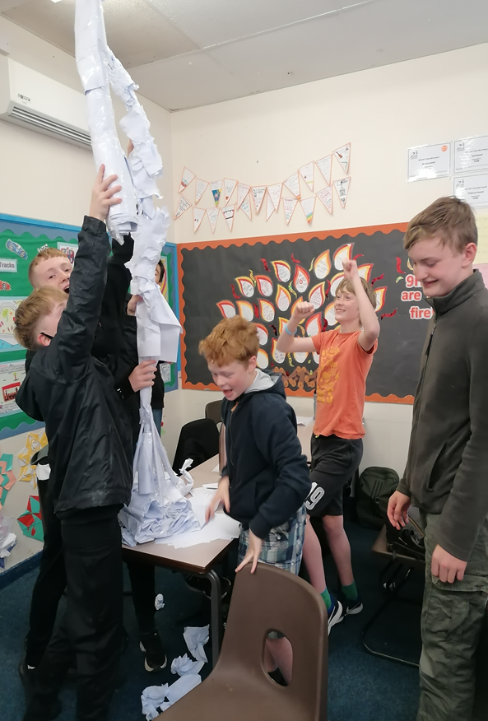
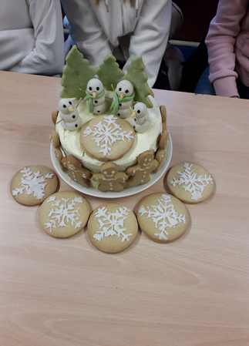
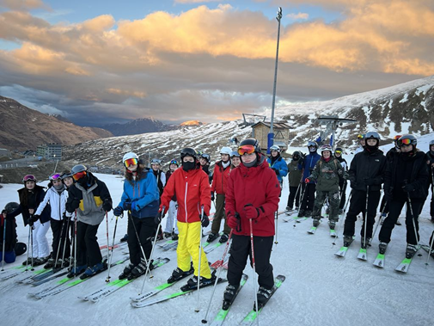
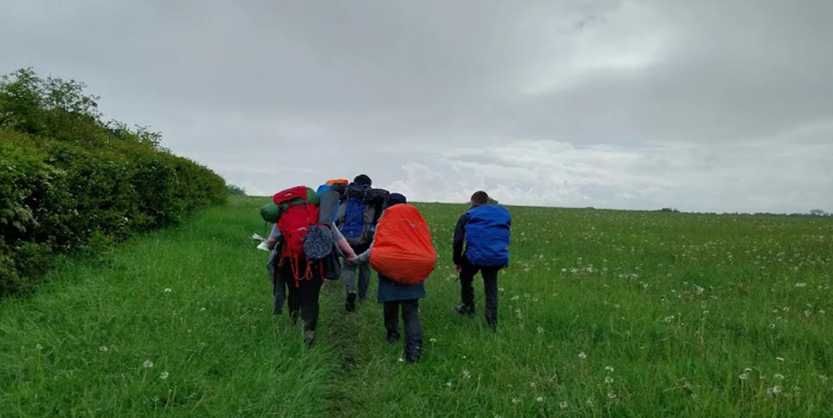
Looking forward to the next seven years

