Slide 1


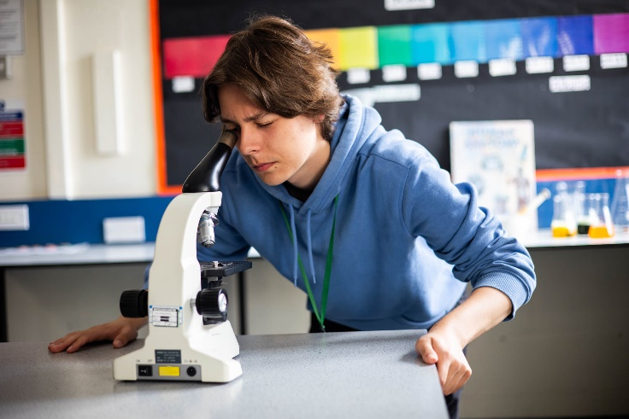

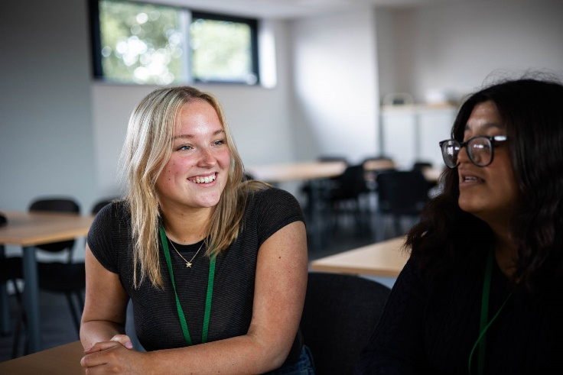
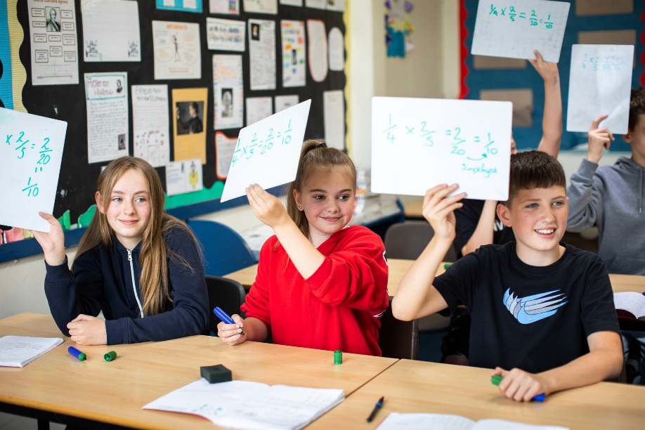
Year 11 Parents Information Evening
October 2025
Preparation for mock exams and beyond

Slide 2
Year 11 Timeline
&
Preparation for Mock Examinations
Hannah Evans – Deputy Headteacher

Slide 3
Year 11 Timeline
October
Drop-in sessions start
Focus groups identified
Attitude to Learning grades assigned
1-1 meetings with the Senior Team
November
Drop-in sessions
Mock Exams
Sixth Form Open Evening
December
Apply for Sixth Form
Teachers highlight gaps from mocks
Drop-in sessions
Practical coursework deadline.
January
Mock results day
Parents consultation meeting
Mock results review
February
Drop-in sessions
March
Attitude to Learning grades assigned
Coursework deadlines
Drop-in sessions
April
In class mock exams (some subjects)
Language speaking exams begin
May/June/July
GCSE written examinations begin.
Final exam date is 24th June
Sixth Form Transition Day Friday 3rd July

Slide 4
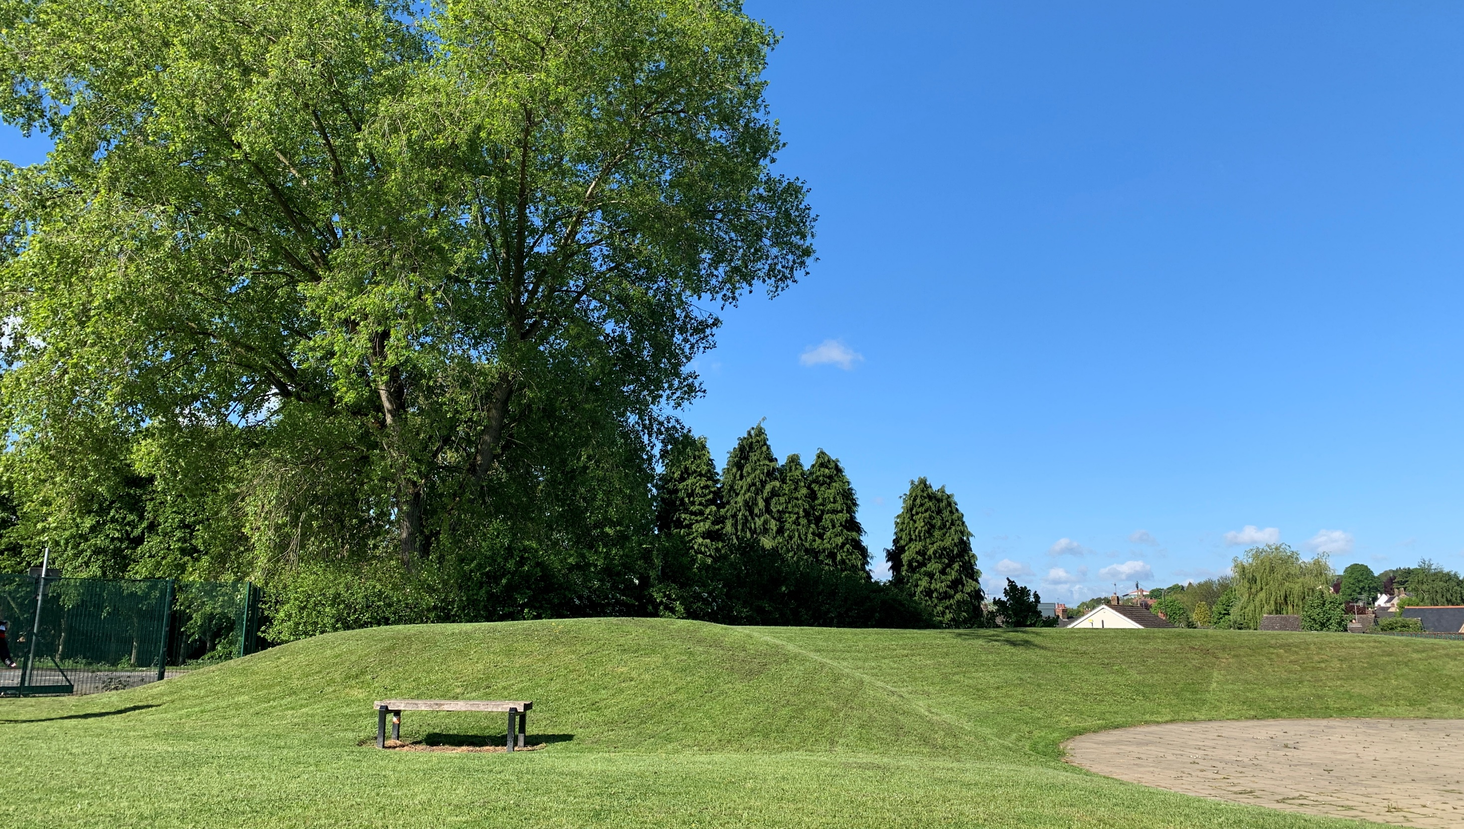
Mock Exams: Monday 10th November – Wednesday 26th November
There are also Language speaking exams in the weeks before
Notes:
When do they need to apply for sixth form
When are sixth form interviews
When are careers interviews? etc

Slide 5
Students will sit mock exams for all subjects where there is a final exam in the summer In some subjects, students will sit more than one paper
Notes:
When do they need to apply for sixth form
When are sixth form interviews
When are careers interviews? etc

Slide 6
Mock Exams Monday 10th November
The mock exams help to prepare for the real GCSEs
How to revise
What to revise
How to manage emotions in the build up to the exams
Procedures and routines
Examination rules
How to manage time in the exam
How to keep going during the exam
What happens on results day
How to deal with the work load
Notes:
When do they need to apply for sixth form
When are sixth form interviews
When are careers interviews? etc

Slide 7
Exam Preparation
Our Examination Team will:
Provide each student with an identification card
Provide details of seat numbers for each exam
Post details of the seating plans outside the exam hall
Provide an exam timetable
We will be providing some resources for revision.
Notes:
When do they need to apply for sixth form
When are sixth form interviews
When are careers interviews? etc

Slide 8
What can you do?
Have a copy of the mock timetable available
Ensure they have somewhere quiet to revise
Ensure they have time to revise
Let them have time to relax
Speak to their place of work to reduce their hours
Check that they have the equipment they need
Encourage them to come to drop in sessions
Encourage them to have breakfast before school
Ensure they get to bed at a reasonable time
Ensure they are in school
Notes:
When do they need to apply for sixth form
When are sixth form interviews
When are careers interviews? etc

Slide 9
What Year 11 say…
Take my phone away (Good luck!)
Reward me
Help me to go through answers
Test me
Make Dad stop singing – it’s distracting!
Get me some new furniture
Trust me to revise
Understand that we don’t revise like you did
Buy me some pens
Notes:
When do they need to apply for sixth form
When are sixth form interviews
When are careers interviews? etc

Slide 10
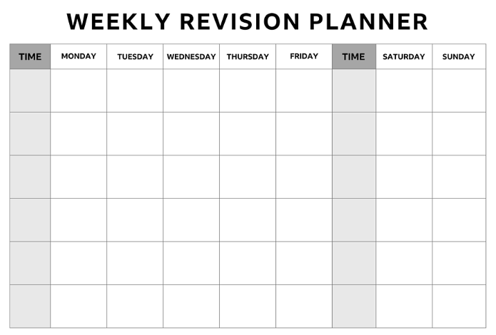
Revision Timetable
Notes:
When do they need to apply for sixth form
When are sixth form interviews
When are careers interviews? etc

Slide 11
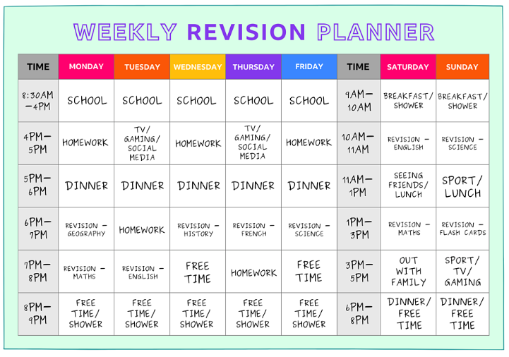
Revision Timetable
Notes:
When do they need to apply for sixth form
When are sixth form interviews
When are careers interviews? etc

Slide 12
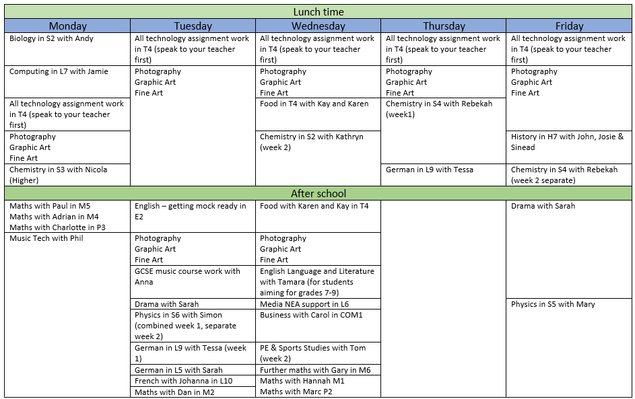
Opportunities in School
Notes:
When do they need to apply for sixth form
When are sixth form interviews
When are careers interviews? etc

Slide 13
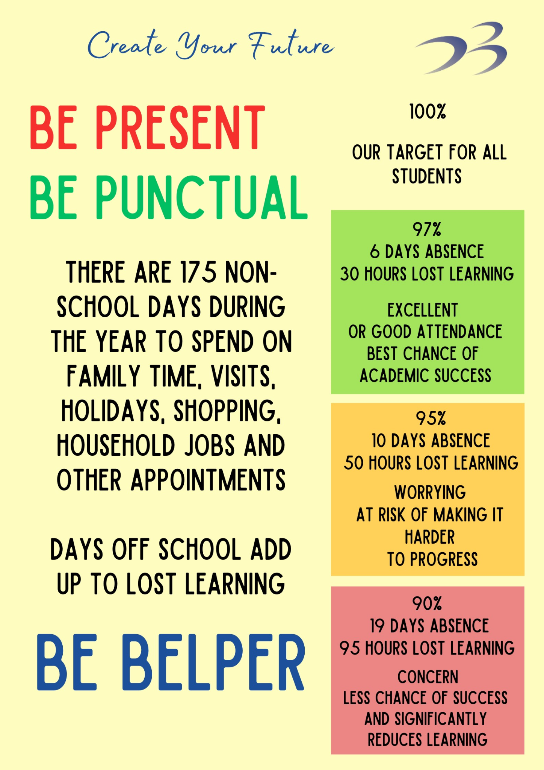
Being in school and being on time is crucial for success and preparing for the future
Lost learning can lead to additional anxiety and pressure to catch up work and risks the student falling even further behind

Slide 14
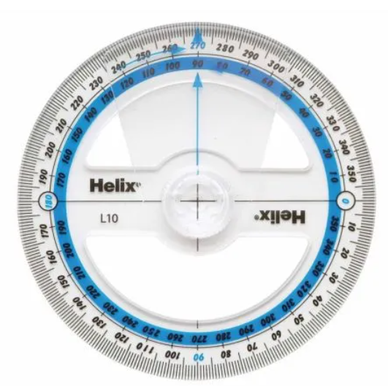


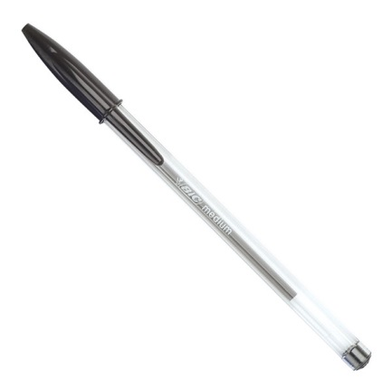



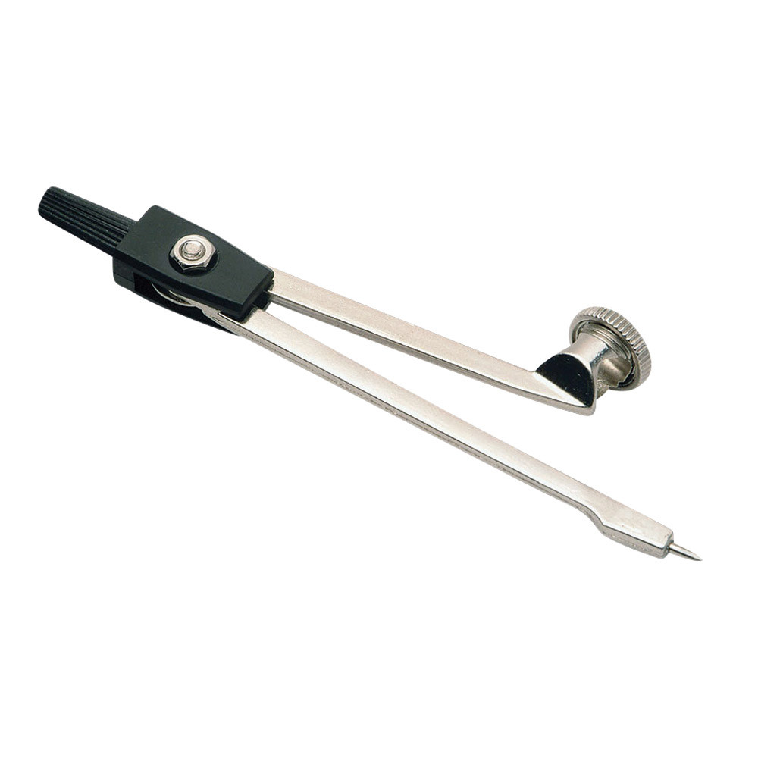

Filled see-through exam pencil case can be bought on Parent Pay
Calculator can be bought on ParentPay

Slide 15

Prohibited items
Phones
Watches
Airpods
Revision notes
They are not allowed to be left in pockets or bags, even if they are switched off.
Leave in lockers
Hand in to invigilators on way in (kept secure and collected at the end of the day)
Notes:
When do they need to apply for sixth form
When are sixth form interviews
When are careers interviews? etc

Slide 16
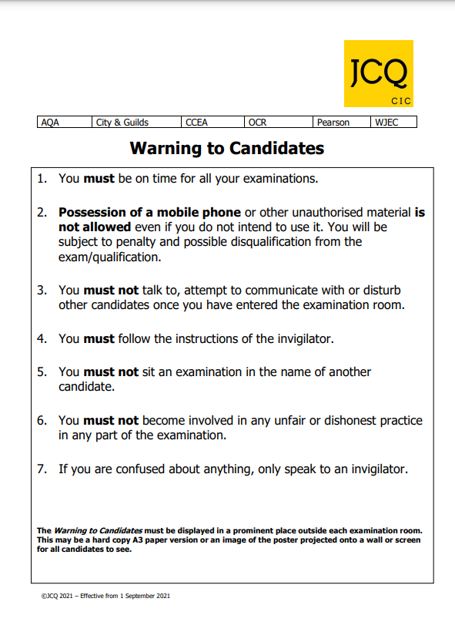
Other Important Information
There is only one sitting of each exam, except for clashes.
Students who miss exams will receive either an X or a U grade.
Special consideration will be made for those with a doctor’s note or for compassionate reasons (eg. bereavement/funeral etc)
Notes:
When do they need to apply for sixth form
When are sixth form interviews
When are careers interviews? etc

Slide 17
Mock Results
We will have a mock results day on Monday 5th January (First day back after the holidays)
Students will not receive individual results until then.
Why?
If they haven’t done well they will receive bad news multiple times.
If have done well, less likely to listen to advice on improvements during lessons. The aim is to improve the student, not the work.
Individual questions won’t be repeated on the real exams, but the strategies will.
Notes:
Improving the student, not the work.

Slide 18
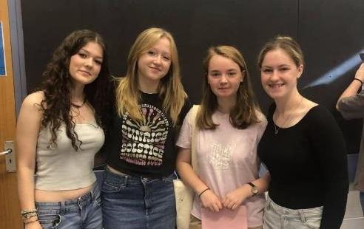
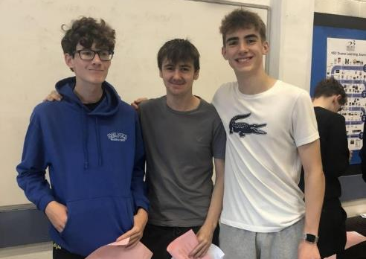
Mock Results
GCSE results are never much higher than mock results…
These will give a good indication of your actual grades so you can plan accordingly.
Notes:
When do they need to apply for sixth form
When are sixth form interviews
When are careers interviews? etc

Slide 19
Advice from Year 12
Actually pay attention in class!
Start revising as soon as possible!
Teachers know exactly what’s going to come up so listen to them!
Make the most of help from your teachers.!
Notes:
When do they need to apply for sixth form
When are sixth form interviews
When are careers interviews? etc

Slide 20
16-18 Pathways
The process whereby we support students to make informed decisions about their future after Year 11
1-1 meetings have taken place with the Senior Team, Head of Year, Sixth Form Team and our Careers Advisor to discuss students’ initial thoughts
Used the Year 10 mock exam data
Planning how we can support the next steps
Notes:
When do they need to apply for sixth form
When are sixth form interviews
When are careers interviews? etc

Slide 21
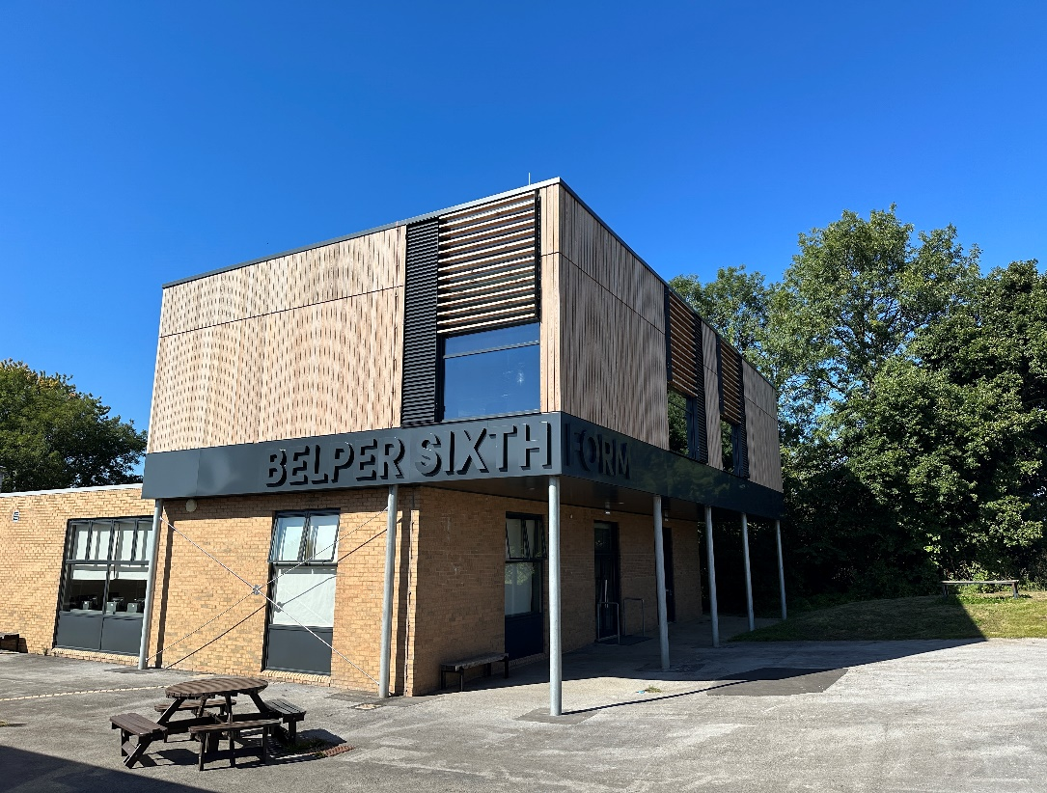
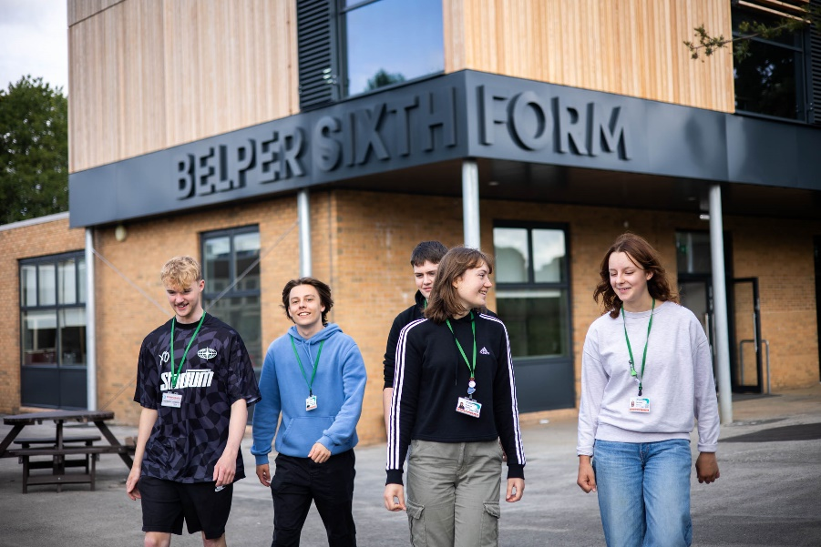
Sixth Form Open Evening
Thursday 6th November
5.30 – 7.30pm
Notes:
Did an assembly with year 12. settle in so quickly.
Looking round sixth forms with son at the moment – he really wishes he had a sixth form at his school

Slide 22
Sixth Form: Subjects
Biology
Business
Criminology
Drama
French
Maths
Media Studies
Chemistry
Computer Science
D&T: 3D Design
History
Food Technology
Geology
Psychology
Music
Photography
Economics
English Language
English Literature
Geography
Sociology
Physics
Fine Art/Graphic Art
Film Studies
German
Physical Education
Politics
Further Maths
Core Maths
BTEC Art
Notes:
When do they need to apply for sixth form
When are sixth form interviews
When are careers interviews? etc

Slide 23
Sixth Form Open Evening
Speak to subject specialist staff about the subjects they are interested in
Learn more about how the course is assessed
Discuss course content
Understand the entry requirements
Notes:
When do they need to apply for sixth form
When are sixth form interviews
When are careers interviews? etc

Slide 24
Sixth Form
The entry requirements are 5 GCSEs at grades 4-9 including Maths and either English Language or English Literature
Additionally, students must meet the subject specific entry requirements for the courses they choose
We have these entry requirements to ensure that students can thrive in their chosen subjects and they allow classes to study the curriculum content in depth
Notes:
When do they need to apply for sixth form
When are sixth form interviews
When are careers interviews? etc

Slide 25


What next after year 11?
Richard Leach - Careers Coordinator

Slide 26
Next Steps for year 11
Year 11 are now at the stage were they need to start to consider their options for after they have completed year 11.
We will support year 11 students with one to one careers guidance and the highlighting of opportunities.

Slide 27
What are the main post 16 options?
Sixth Forms – These mainly offer A Levels and Level 3 BTECs
Colleges – These offer a wide range of courses, many of which are vocational and work related
Training providers – These are small colleges which offer vocational and pre-apprenticeship courses
Apprenticeships – These are offered by national, regional and local employers
The GCSE entry profile for these options varies

Slide 28
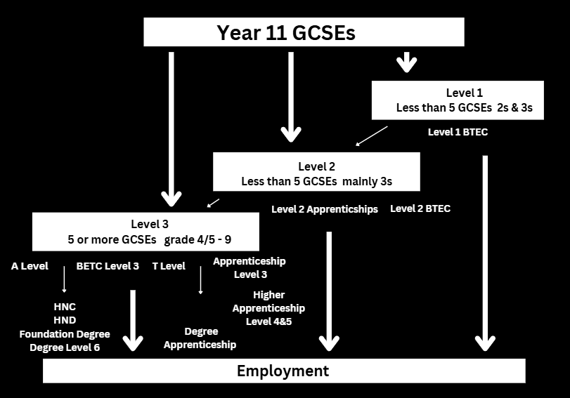
The grades achieve at GCSE determine what level of course or training student’s can progress on to after year 11

Slide 29
Post-16 Study & Training The HM Government say’s you need to be in education, employment or training until you are 18. The main types of courses and training available to students after year 11
Level 1 BTECs (Introductory) (Vocational work related)
Level 2 BTECs (Intermediate) (Vocational work related)
Level 3 BTECs (Advanced) (Vocational work related)
T Levels – Technical Levels (Advanced) (Technical)
A Levels (Advanced) (Academic)
Level 2 Apprenticeships (Work based & paid)
Level 3 Apprenticeships (Work based & paid)

Slide 30
Vocational, Academic & Technical
Vocational
Academic
Work related
Specialist facilities, workshops, salons, computer rooms, classroom
More hands on, practical elements
Assessment by observation, portfolio, course work projects, exams, performance
Apprenticeship involve 80% actual paid work
Classroom based
Similar in style to GCSEs but more difficult
Assessed my exams
Technical
A mixture or academic and vocational, T Levels involve 20% Work Experience

Slide 31
General Advice for year 11 students
Attending Sixth Form & College open evenings. This will give students the opportunity to see what courses, training and facilities are on offer, talk to staff and students.
Start writing a CV and personal statement, students can use information from these to complete applications.
Make applications to Sixth Forms & Colleges.
Complete all stages of the applications process, this can involve submitting personal statements, attending interviews, accepting offers and uploading GCSE results.

Slide 32
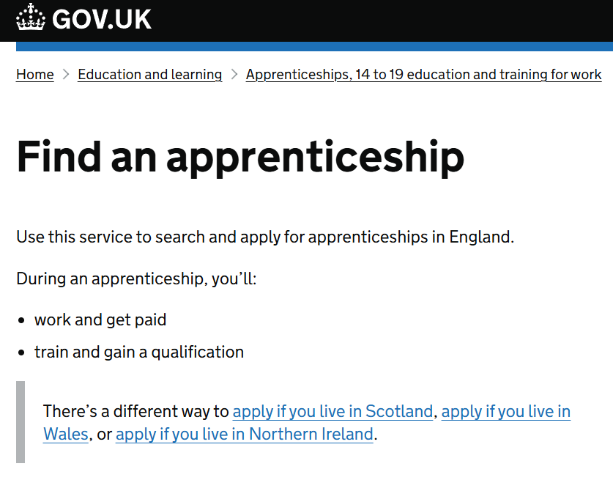
Apprenticeships
If students are interested in applying for apprenticeships, vacancies are advertised on the government’s ‘Find an Apprenticeship’ Website
This is a good place to start looking,
Students should ensure that
apprenticeships start after they complete their
GCSE exams in the summer.
https://www.gov.uk/apply-apprenticeship

Slide 33

If students would like arrange a early Careers Guidance Meeting
They can drop into my office at break or lunchtime
Email me rbl@belperschool.co.uk
Tutors can refer students to email me
Parents & carers are welcome
to email me

Slide 34

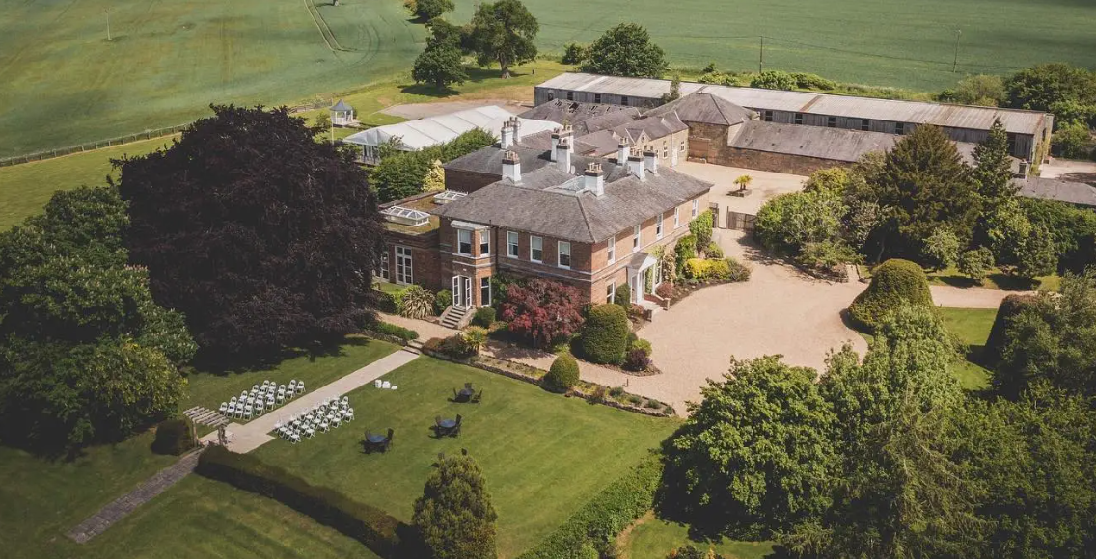
Prom
Wednesday 26th June
19:00 - 23:00 (Doors open at 19:00)
Eligibility criteria
All students are invited to attend the prom. However, in order to ensure that the event is a positive and respectful celebration, entry will be decided at the discretion of the Head of Year and the Senior Leadership Team.
Dress code
Dress to impress

Slide 35
We want this evening to be a celebration of our students' achievements and a lasting memory of their time at Belper School. Thank you for your continued support in making this event safe, fun and successful.
If you have any questions, please contact Wain Marriott (Head of Year 11) at belperschool@belperschool.co.uk

